Slide 1

LUNG CANCER PREDICTION SYSTEM

Slide 2

RAURKELA INSTITUTE OF MANAGEMENT STUDIES
Guided By: Presented By:
Prof. Bibhubendu Panda Amit Kumar Patel
2205260001

Slide 3

DEVELOPERS
AMIT KUMAR PATEL

Slide 4
INTRODUCTION
Lung Cancer Prediction System using EfficientNet is a deep learning project that aims to predict the presence of lung cancer based on chest X-ray images. It is built using Python Django web framework and utilizes an SQLite database. The system has three main modules - user, admin, and doctor.
The user module includes features such as sign up, login, prediction, view prediction history, and a list of doctors available based on the user's location. After the prediction, if the user is diagnosed with a disease, doctors in the same city will be recommended to the user. The user can also edit their profile, change their password, and logout.
The admin module includes login, a dashboard to view user and prediction results counts, view prediction history, registered users, registered doctors, change password, and logout.
The doctor module includes login, view prediction history of patients from the same city, edit profile, change password, and logout. This feature helps doctors to get patient information for lead generation.

Slide 5
PROBLEM DEFINITION
The problem that the Lung Cancer Prediction System using EfficientNet aims to address is the early detection and prediction of lung cancer. Lung cancer is one of the most common types of cancer, and it is often not detected until it has progressed to an advanced stage, which can limit treatment options and lead to a poorer prognosis. By using deep learning and image analysis techniques, this system seeks to accurately predict the likelihood of a patient having lung cancer based on their medical imaging data, allowing for earlier detection and more effective treatment options.

Slide 6
OBJECTIVE
The main objectives of the Lung Cancer Prediction System using EfficientNet are:
To develop an accurate deep learning model for predicting the presence of lung cancer in patients based on CT scan images.
To provide an easy-to-use web application for users to input their CT scan images and receive a prediction of the likelihood of lung cancer.
To create a user-friendly interface for doctors to view patient predictions and medical history in order to assist with diagnosis and treatment decisions.
To reduce the time and cost associated with traditional lung cancer diagnosis methods by using an automated, computer-based approach.

Slide 7
GOAL
The goal of Lung Cancer Prediction System using EfficientNet is to develop an accurate and efficient deep learning model that can predict the likelihood of a patient having lung cancer based on their medical records and diagnostic reports. The system aims to assist doctors and healthcare professionals in the early detection and diagnosis of lung cancer, thereby improving patient outcomes and reducing mortality rates associated with this disease. The ultimate goal is to provide a reliable and accessible tool for lung cancer prediction that can be used by medical practitioners to provide personalized treatment and care for their patients.

Slide 8
NEED OF THE SYSTEM
The need for the Lung Cancer Prediction System using EfficientNet can be attributed to the fact that lung cancer is a major health concern worldwide and the early detection of lung cancer can significantly improve the chances of successful treatment. With the increasing availability of medical data, it has become important to develop accurate and efficient methods for the early detection of lung cancer. The Lung Cancer Prediction System using EfficientNet is designed to meet this need by utilizing deep learning techniques to accurately predict the probability of lung cancer in patients based on their medical data. This system has the potential to improve the accuracy of lung cancer diagnosis and provide a better chance for successful treatment.

Slide 9
PROPOSED SYSTEM
The proposed system of Lung Cancer Prediction System using EfficientNet is a deep learning-based predictive model that utilizes medical imaging data to accurately predict the likelihood of a patient having lung cancer. The system is built using the EfficientNet architecture, which is known for its superior performance and efficiency in image classification tasks. The system takes input from CT scan images of the patient's lungs, preprocesses them, and feeds them into the EfficientNet model. The output of the model is the probability of the patient having lung cancer, which can be used by medical professionals to make informed decisions regarding the patient's diagnosis and treatment plan. The system also includes a user interface, allowing users to easily input their medical imaging data and receive a prediction. Additionally, the system includes modules for doctors and administrators, allowing them to manage patient data and view predictions made by the model.

Slide 10
USER MODULES
Signup: A user can create a new account by providing basic details like name, email, and password.
Login: The users can log in to their account using the registered email and password.
Prediction: The users can upload their chest X-ray image and get the prediction result if the X-ray shows any indication of lung cancer or not.
View Prediction History: The users can view their past prediction results in their profile.
View Doctors: Based on the user's area/city, the system recommends doctors who specialize in treating lung cancer. This is done after the prediction, in case the system detects lung cancer in the user's chest X-ray.

Slide 11
USER MODULES(Continue)
Edit Profile: Users can update their profile information like name, email, and contact details.
Change Password: Users can change their login password for security purposes.
Logout: Users can log out of the system once they have finished their session.

Slide 12
DOCTOR MODULES
Login: Allows the doctor to log in to their account using their registered credentials.
Dashboard: Provides an overview of the doctor's account, including the total number of patients they have treated, the number of patients they have diagnosed with cancer, and the number of patients they have referred to a specialist.
Patient History: Allows the doctor to view the complete medical history of each patient they have treated. This includes previous diagnoses, lab results, and radiology reports.

Slide 13
DOCTOR MODULES(Continue)
Profile Management: Allows the doctor to manage their account details, including personal information, contact details, and login credentials.
Logout: Enables the doctor to log out of their account and end their session.

Slide 14
ADMIN MODULES
Login: The admin will have a unique username and password to access the admin panel.
Dashboard: This module will allow the admin to view the total number of users registered, total predictions made, and other related statistics.
View Prediction Results: The admin can view the predictions made by the users along with their details and prediction results.
View Registered Users: The admin can view the list of registered users along with their details.
View Registered Doctors: The admin can view the list of registered doctors along with their details.
Change Password: The admin can change their password using this module.
Logout: The admin can log out of the admin panel using this module.

Slide 15
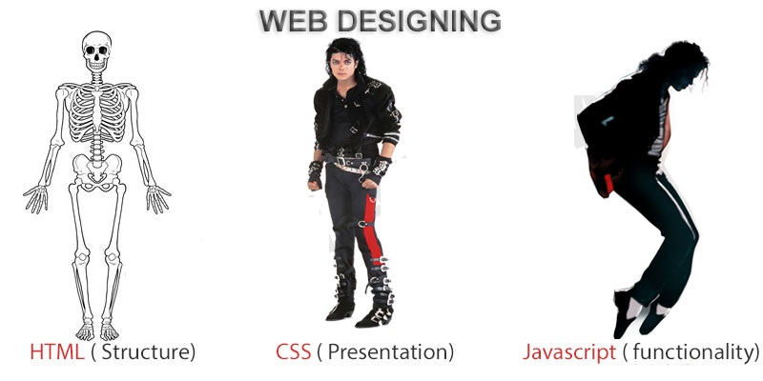
FRONTEND (LANGUAGE USED)
HTML (HYPERTEXT MARKUP LANGUAGE)
CSS (CASCADING STYLE SHEET)
BOOTSTRAP (FRAMEWORK OF CSS AND JS)

Slide 16

BACKEND
PYTHON DJANGO
SQLITE (DATABASE)

Slide 17
SOFTWARE USED
PYTHON INTERPRETER
PYCHARM IDE (INTEGRATED DEVELOPMENT ENVIRONMENT)
NOTEPAD++ OR ANY OTHER TEXT EDITOR
CHROME OR ANY OTHER BROWSER

Slide 18
Algorithm Used:-
EfficientNet is a highly efficient deep learning architecture designed for computer vision tasks, including medical image analysis. It optimizes both accuracy and computational efficiency by scaling the model's depth, width, and resolution. In the context of a lung cancer prediction system, EfficientNet can analyze medical images such as chest X-rays or CT scans to accurately predict cancerous or non-cancerous conditions. Its efficiency and effectiveness contribute to improved diagnostic accuracy and potentially earlier detection of lung cancer.

Slide 19
PROJECT SCOPE
The scope of Lung Cancer Prediction System using EfficientNet is significant as it can be used by healthcare professionals, researchers, and organizations in the field of cancer diagnosis and treatment. The system can assist doctors in making accurate predictions and diagnosis of lung cancer, which can ultimately lead to better treatment outcomes and improved patient care. Moreover, the system can be used to analyze large datasets of medical images to identify patterns and insights, which can be used for further research and development in the field of cancer treatment. This can lead to the development of more effective and efficient diagnostic and treatment methods, thereby contributing to the growth of the healthcare industry.

Slide 20
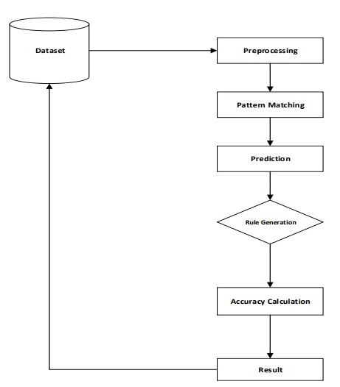
FLOW CHART

Slide 21
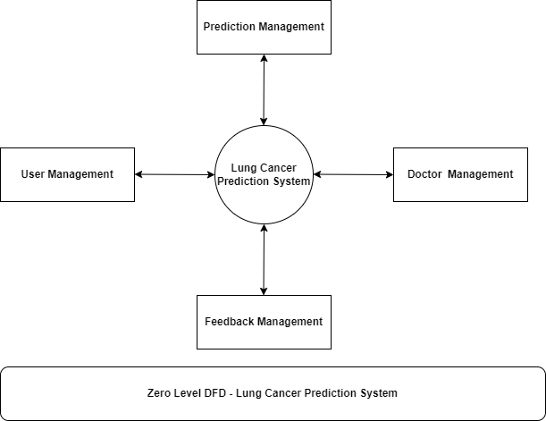
DFD(ZERO LEVEL)

Slide 22
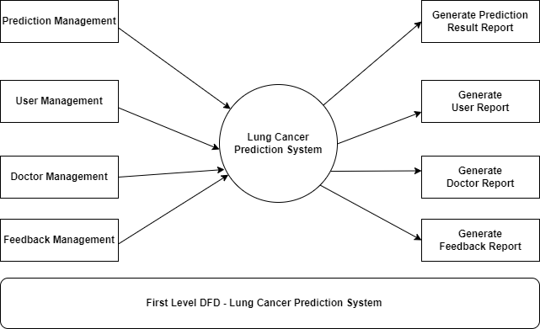
DFD(FIRST LEVEL)

Slide 23
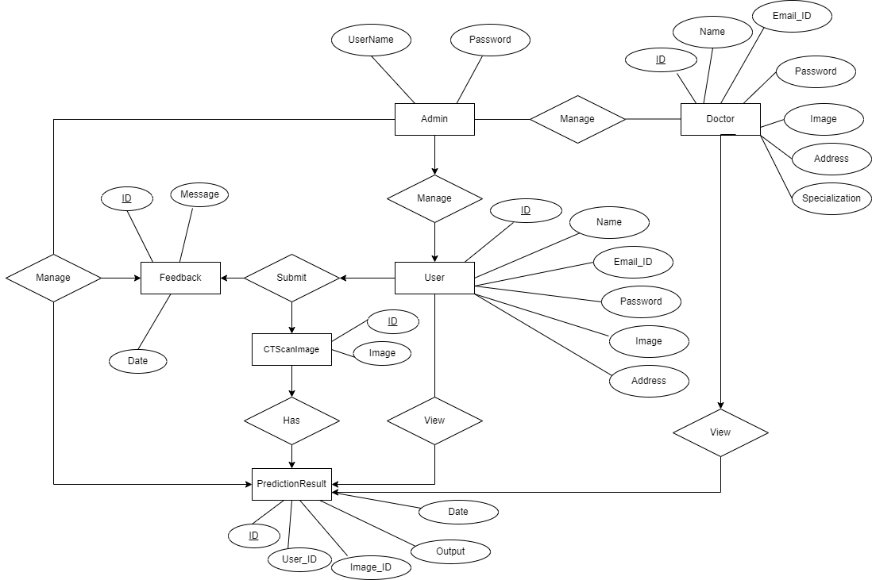
ER DIAGRAM

Slide 24
USE CASE DIAGRAM
Use case diagram consists of use cases and actors and shows the interaction between them. The key points are:
The main purpose is to show the interaction between the use cases and the actor.
To represent the system requirement from user’s perspective.
The use cases are the functions that are to be performed in the module.
An actor could be the end-user of the system or an external system.

Slide 25
USE CASE DIAGRAM - USER
Edit Profile
(Update)
Prediction
View Prediction History
User
Change Password
Logout

Slide 26
USE CASE DIAGRAM - ADMIN
Admin Dashboard
View Prediction History
Manage Reg. Users
(View / Delete)
Admin
Change Password
Logout

Slide 27
USE CASE DIAGRAM - DOCTOR
Edit Profile
(Update)
View Prediction Results
Change Password
Doctor
Logout

Slide 28
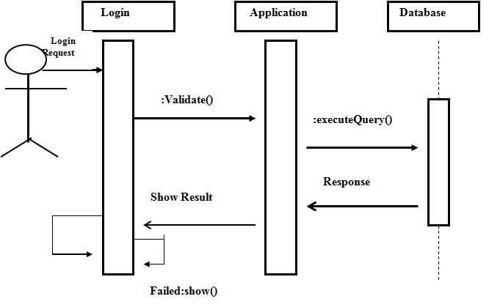
SEQUENCE DIAGRAM

Slide 29
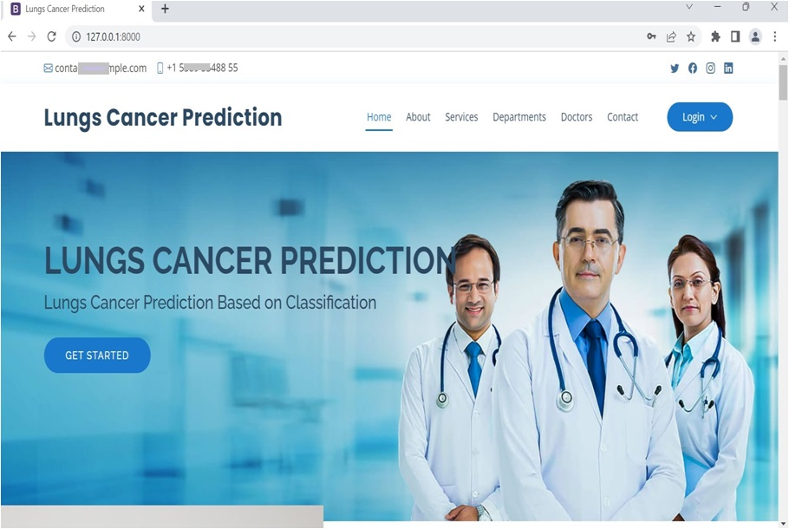
HOME PAGE

Slide 30
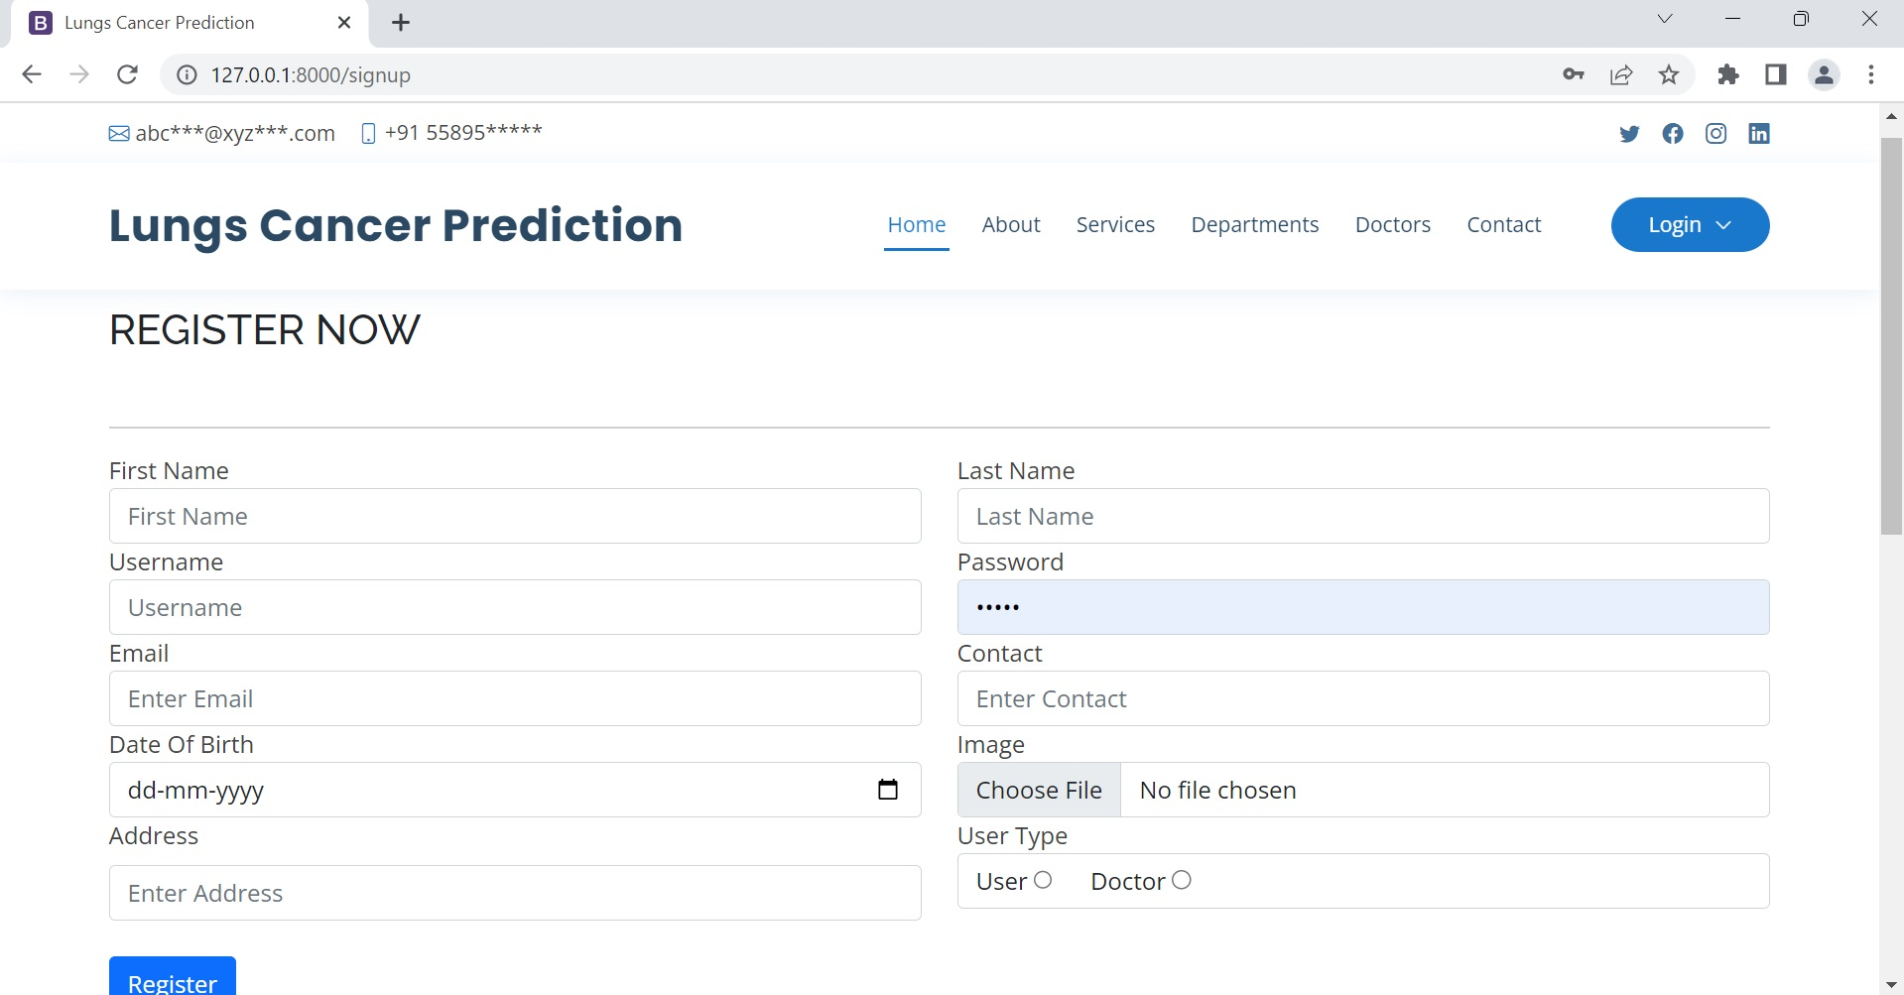
USER REGISTRATION PAGE

Slide 31
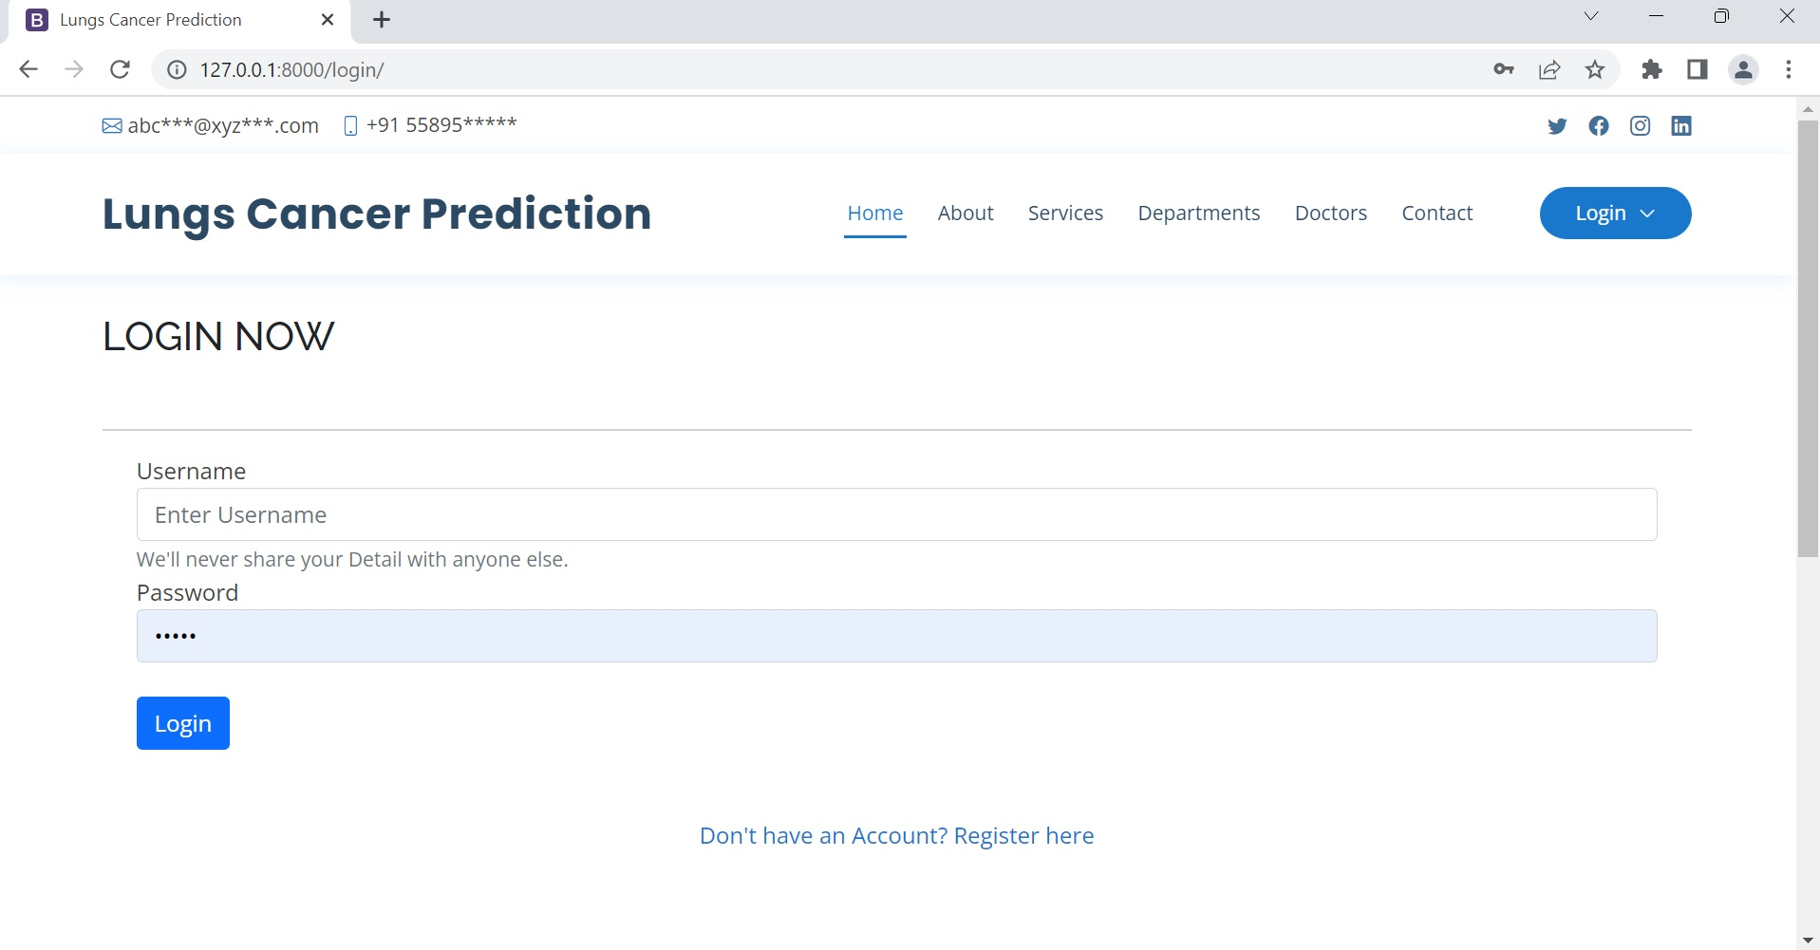
LOGIN PAGE

Slide 32
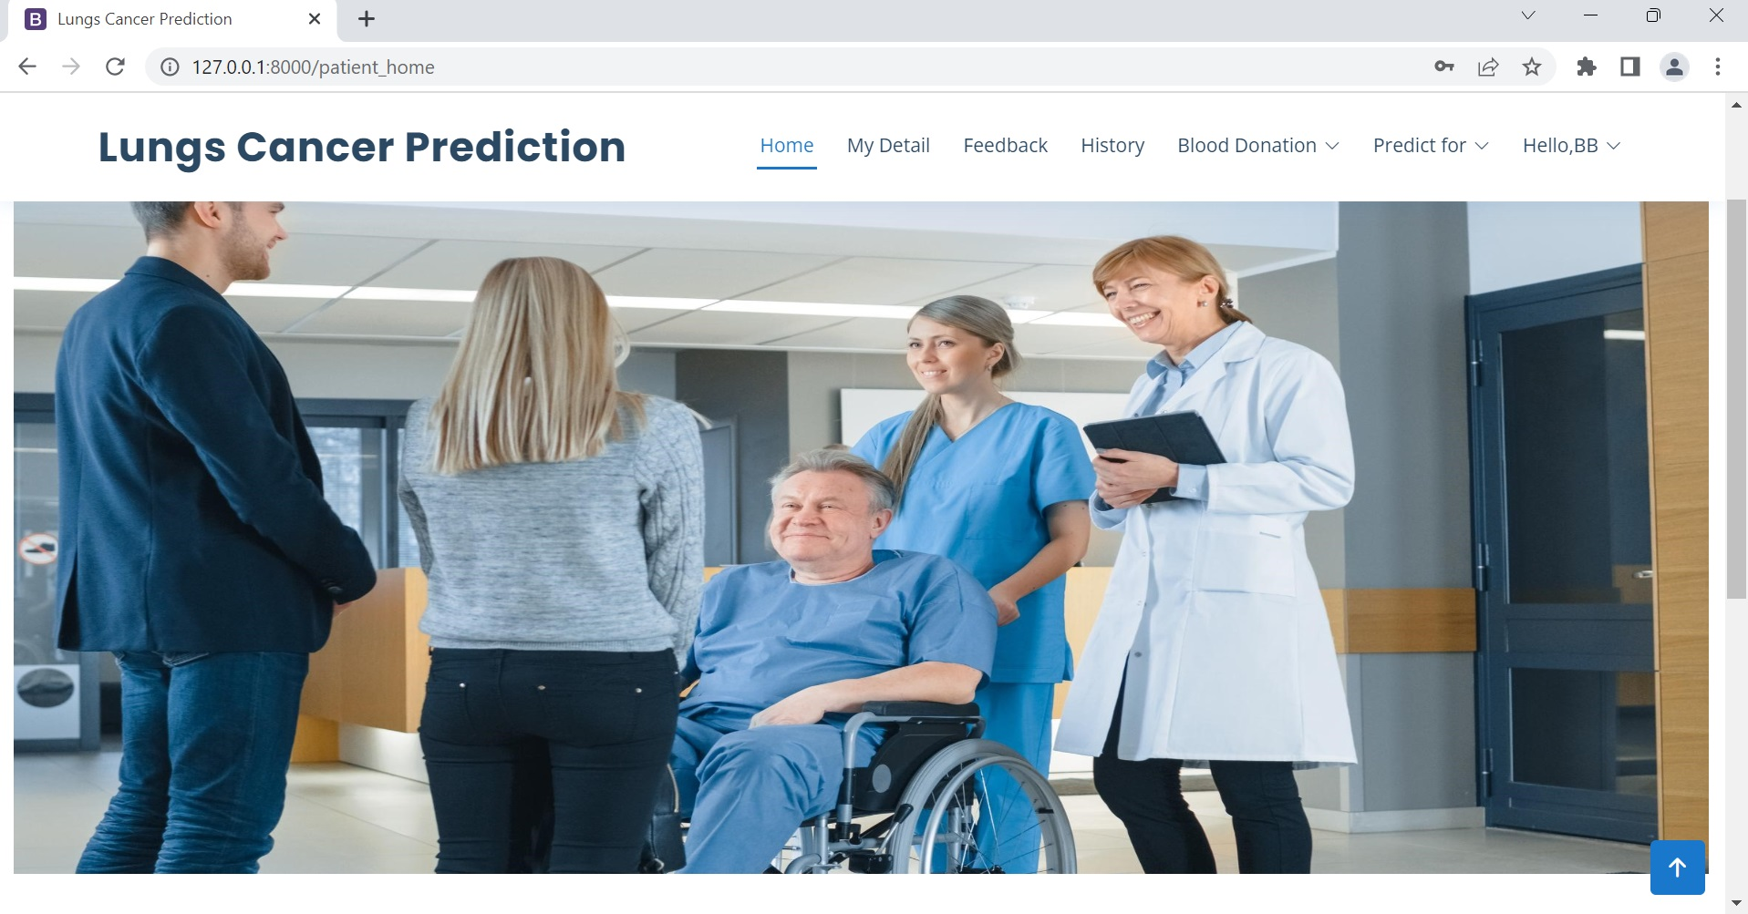
USER HOME PAGE

Slide 33
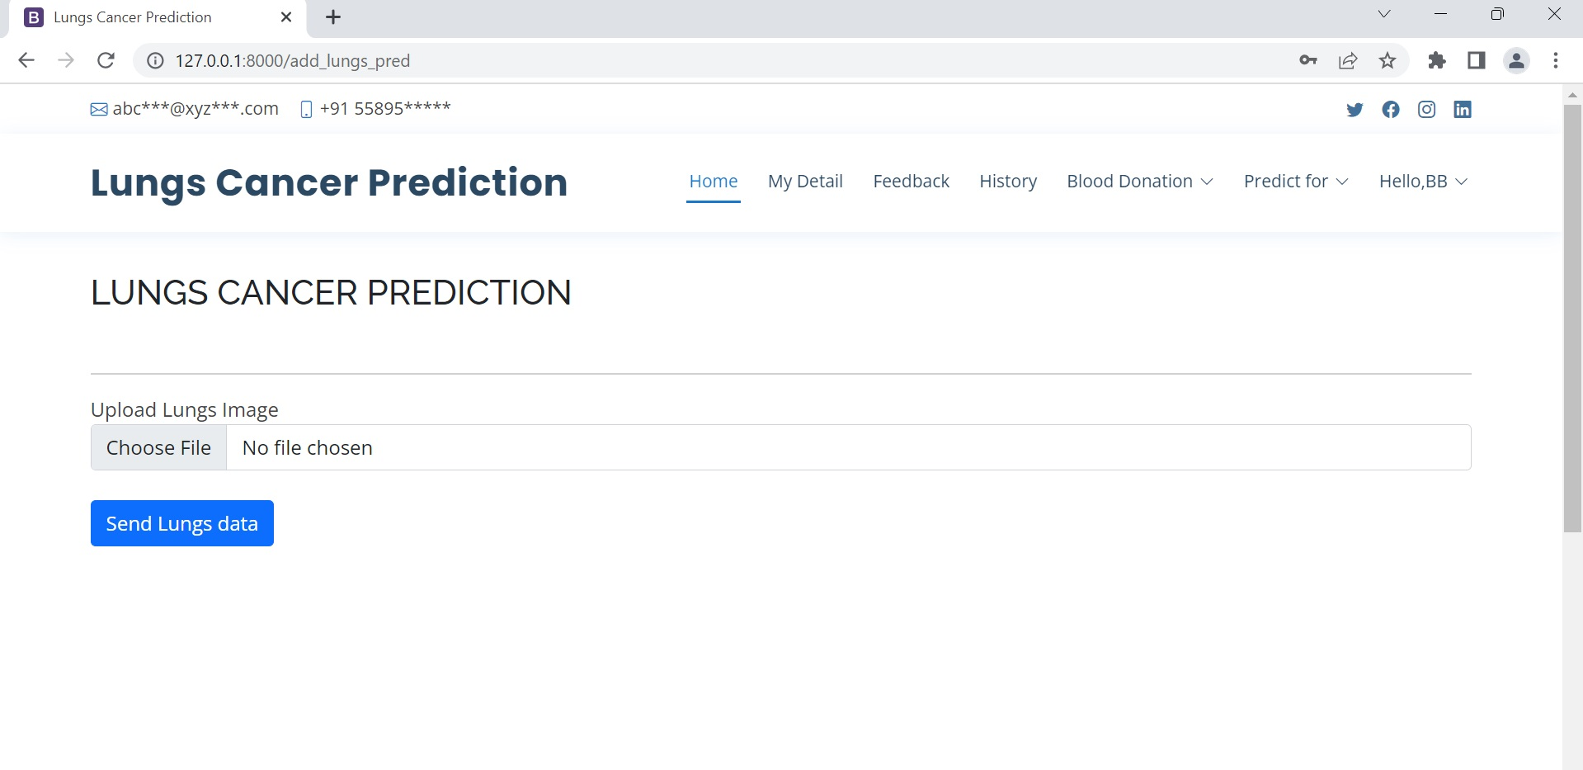
PREDICTION PAGE

Slide 34
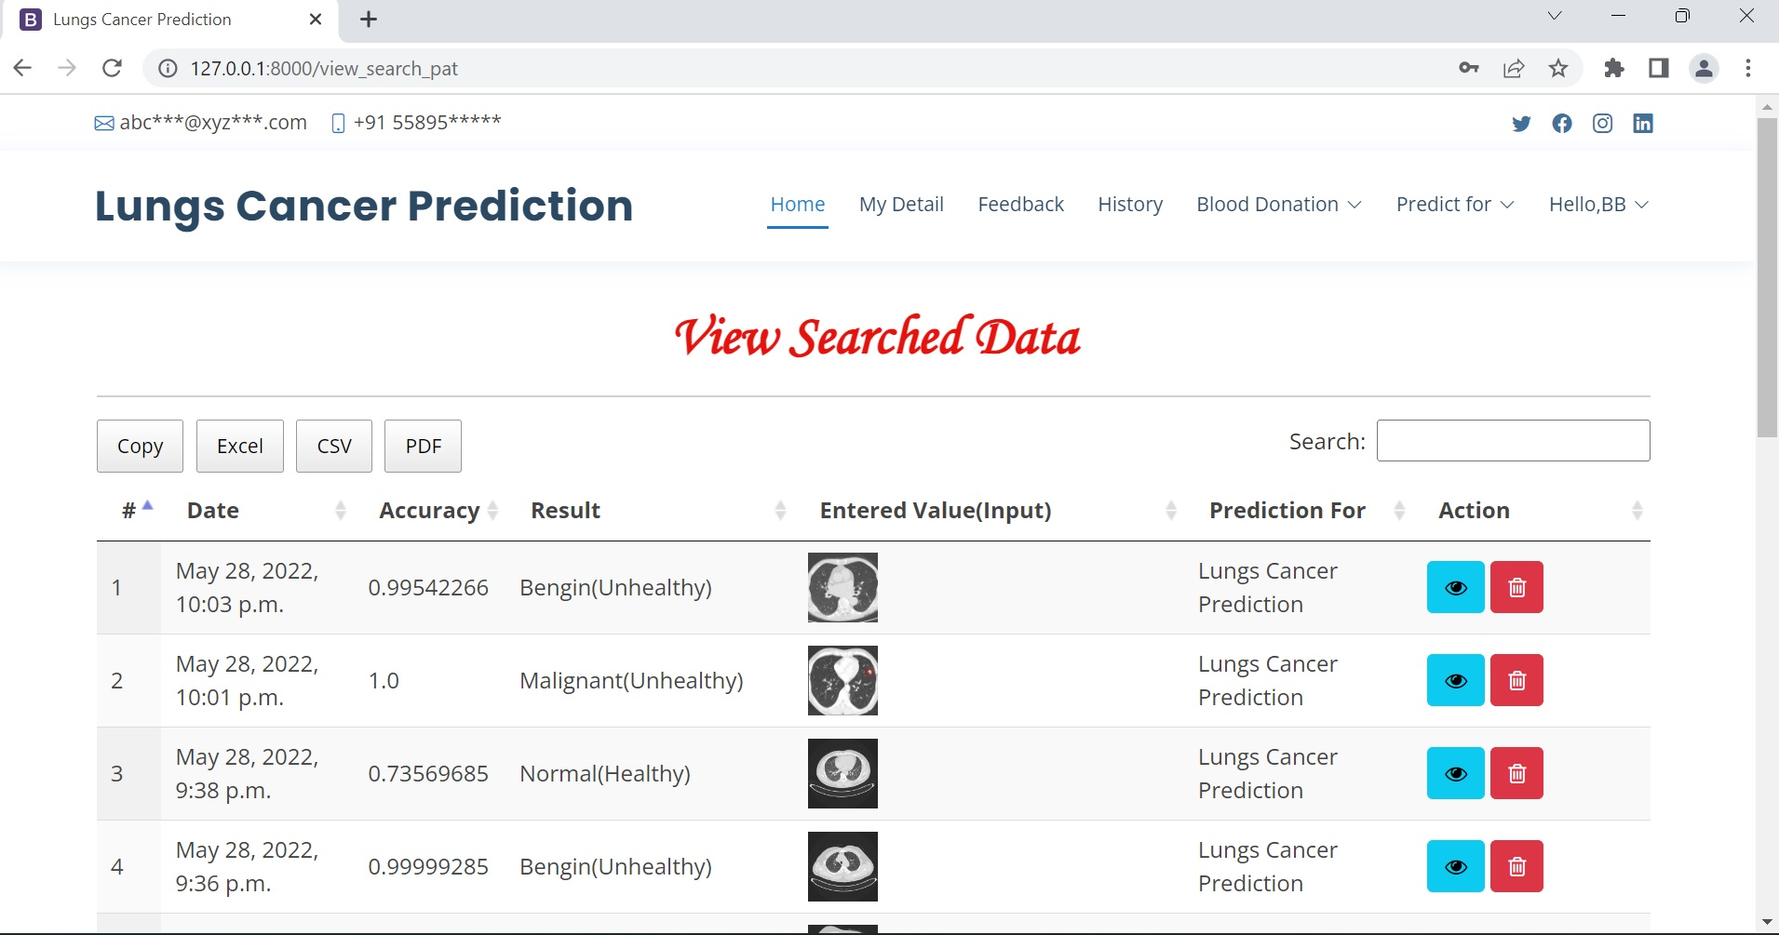
VIEW PREDICTION RESULT HISTORY PAGE

Slide 35
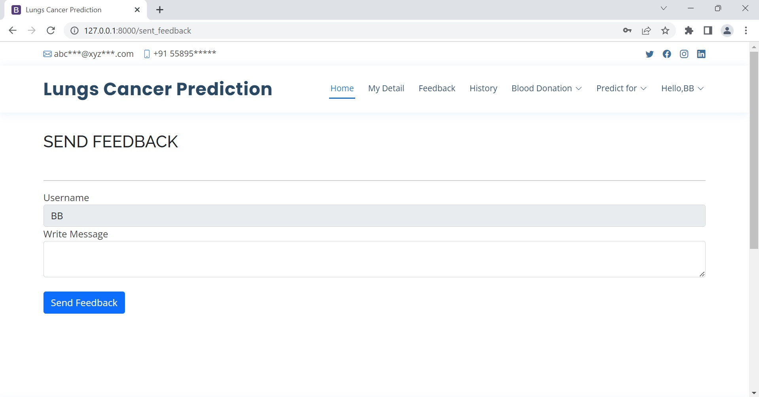
SEND FEEDBACK PAGE

Slide 36
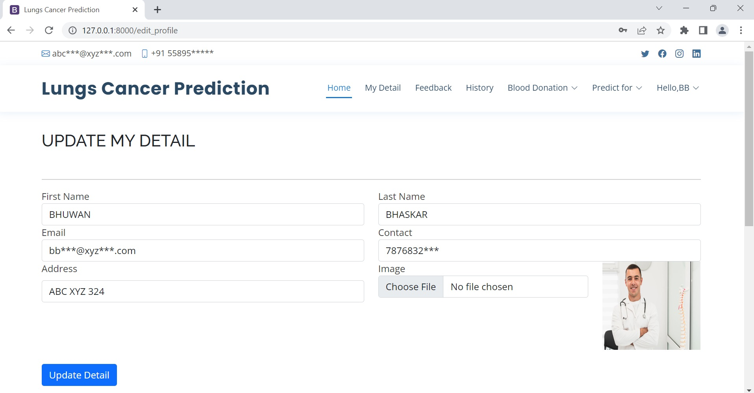
EDIT PROFILE PAGE

Slide 37
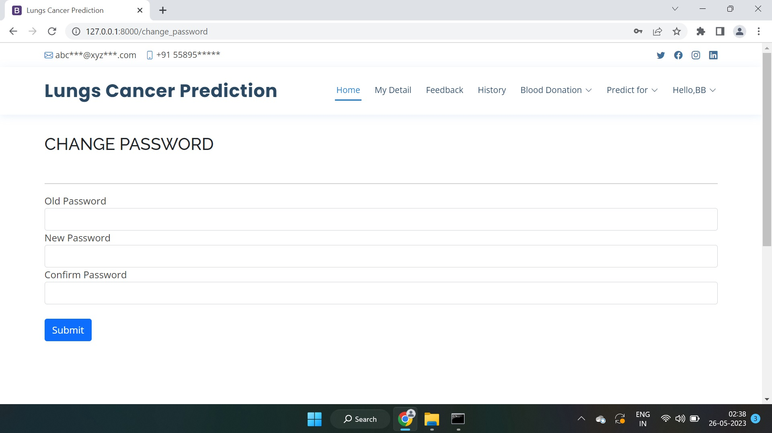
CHANGE PASSWORD PAGE

Slide 38
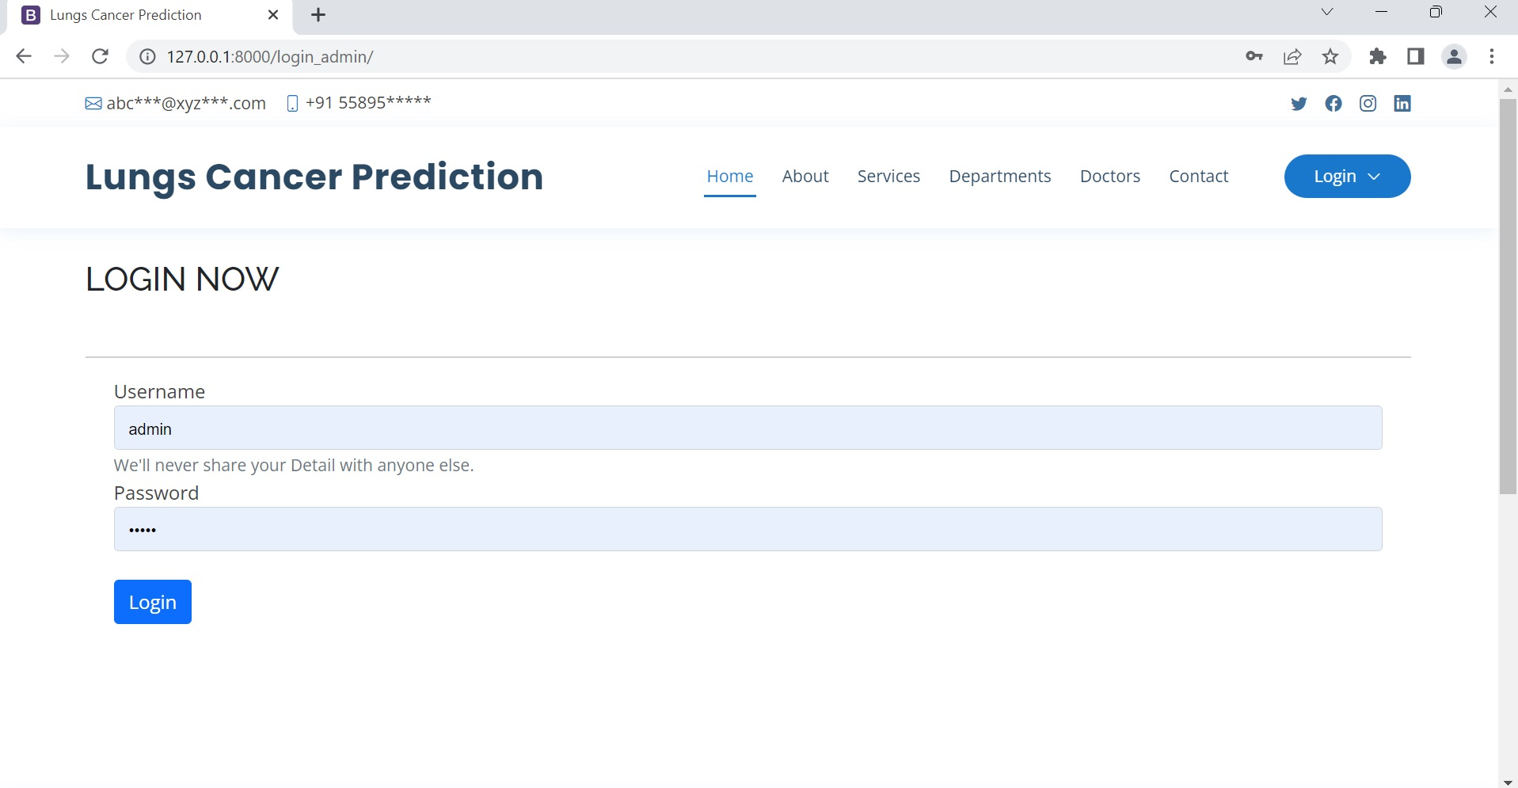
ADMIN LOGIN PAGE

Slide 39
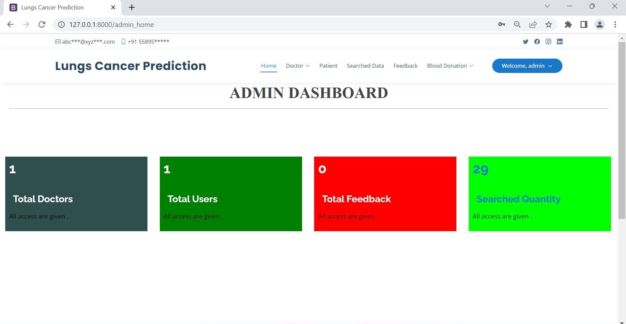
ADMIN DASHBOARD PAGE

Slide 40
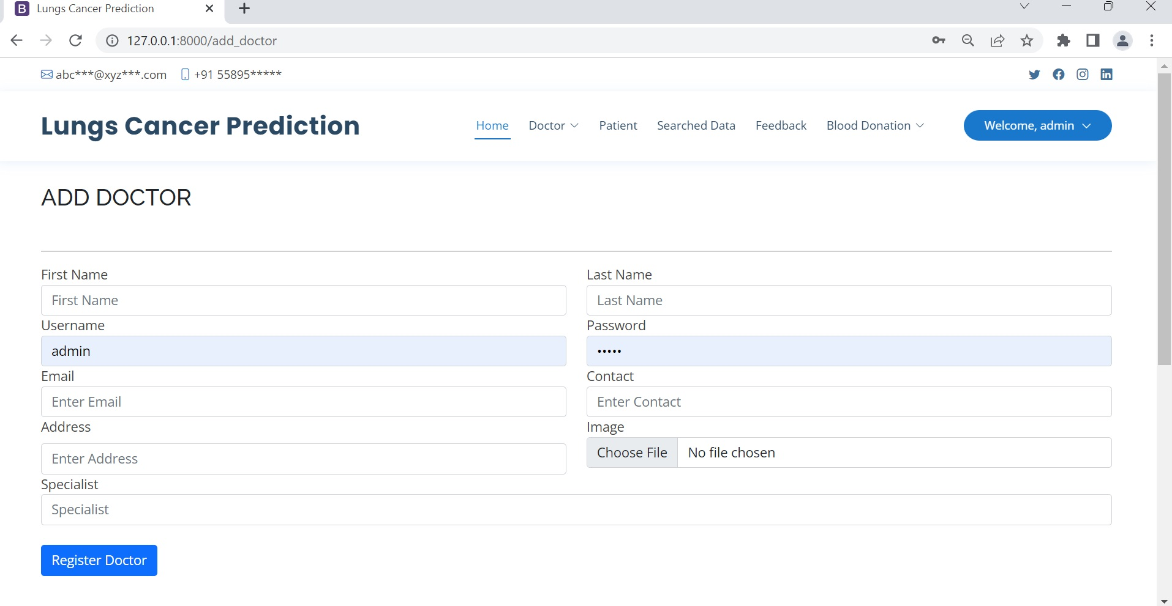
ADD DOCTOR INFO PAGE

Slide 41
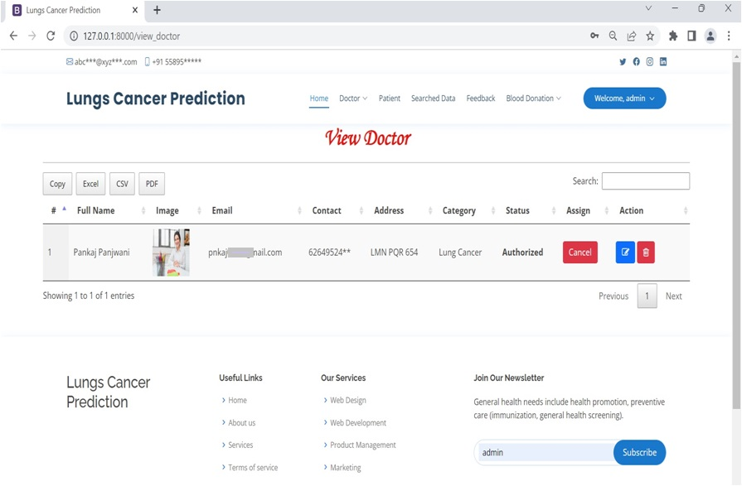
VIEW ALL DOCTORS PAGE

Slide 42
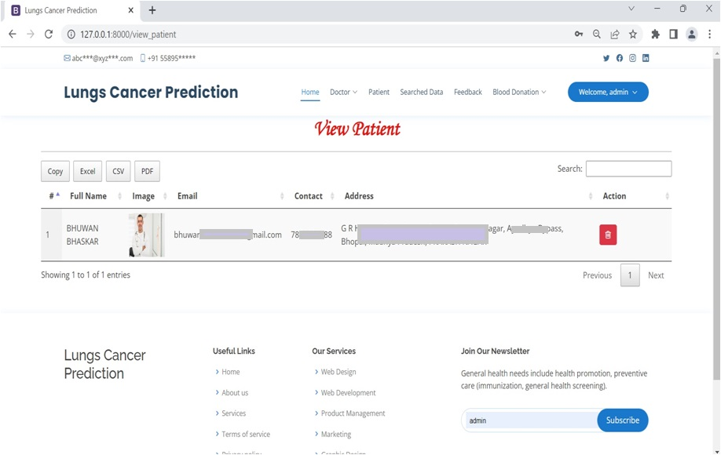
VIEW ALL PATIENT INFO PAGE

Slide 43
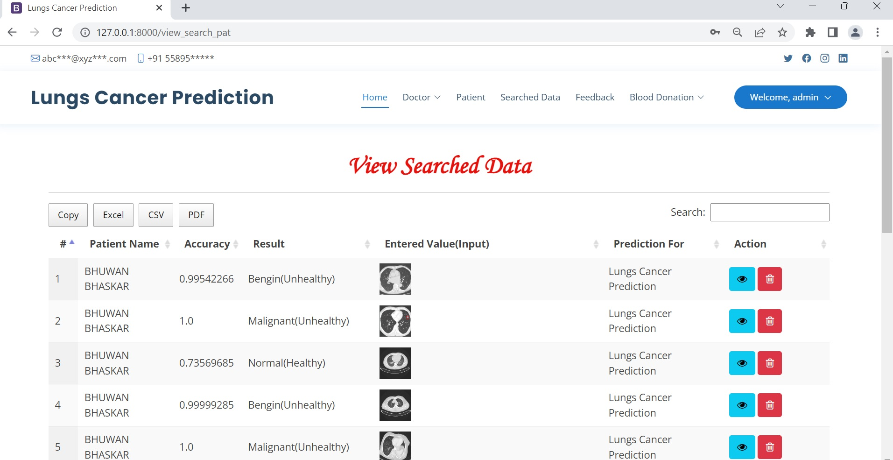
VIEW PREDICTION RESULTS PAGE

Slide 44
FUTURE SCOPE
The future scope of the Lung Cancer Prediction System using EfficientNet is promising. Potential directions for future development include improving model accuracy, extending the system for other types of cancer, developing a mobile application for increased accessibility, integrating Electronic Health Records (EHR), enhancing the user interface, collaborating with medical institutes for better data access, and developing a clinical decision support system. These advancements would contribute to more accurate predictions, wider application, and improved diagnostic capabilities for lung cancer and other cancers.

Slide 45
CONCLUSION
Lung Cancer Prediction System using EfficientNet is an innovative and effective solution to predict lung cancer at an early stage. By implementing deep learning and machine learning techniques, this system can accurately detect and classify lung nodules from CT scan images. It can assist doctors and patients in making informed decisions regarding further diagnosis and treatment. The system is highly scalable, efficient, and cost-effective, making it accessible to a large population. Although there are some limitations, such as the need for high-quality CT scans and a trained model, the benefits of early detection and prevention of lung cancer outweigh them. Overall, the Lung Cancer Prediction System using EfficientNet has the potential to improve healthcare outcomes and save lives.

Slide 46
BIBLIOGRAPHY
FOR PYTHON INSTALLATION
https://www.python.org
FOR HTML , CSS AND PYTHON BASICS
www.w3schools.com
www.javatpoint.com
https://www.geeksforgeeks.org/python-django/
https://panjwanitutorials.com/

Slide 47
BIBLIOGRAPHY
REFERENCE BOOKS
"Hands-On Machine Learning with Scikit-Learn and TensorFlow" by Aurélien Géron.
"Python Machine Learning" by Sebastian Raschka and Vahid Mirjalili.
"Pattern Recognition and Machine Learning" by Christopher M. Bishop.
"Machine Learning: A Probabilistic Perspective" by Kevin P. Murphy.
"Healthcare Analytics: From Data to Knowledge to Healthcare Improvement" by Hui Yang.
"Machine Learning in Medicine: A Complete Overview" by Ton J. Cleophas and Aeilko H. Zwinderman.
"Data Science for Healthcare: Methodologies and Applications" by Radhakrishnan Nagarajan, Foyzur Rahman, and Arunima Srivastava.
Two scoops of Django for 1.11 by Daniel Greenfeld’s and Audrey Greenfield.
Lightweight Django by Elman and Mark Lavin.

Slide 48
THANKYOU

